Slide 1
MapReduce and Apache Spark Mayuni Gunawardhana - 248223N

Slide 2

MapReduce
MapReduce process data parallely in distributed environment
It is used in index and search, classification, recommendation, analytics
Advantages of MapReduce,
Data is processed in parallel
Data locality

Slide 3

Apache Spark
Apache Spark is an open-source distributed computing system designed to process and analyze large-scale datasets efficiently.
It is used in batch processing, interactive queries, real-time analytics, and in machine learning tasks.
Advantages of Apache Spark,
Speed
Ease of Use

Slide 4
Demo

Slide 5
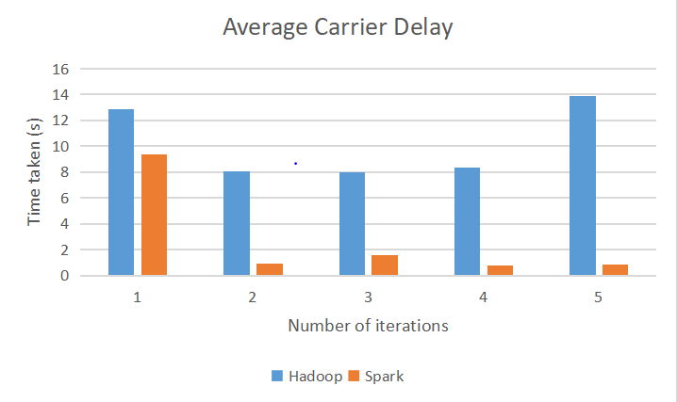
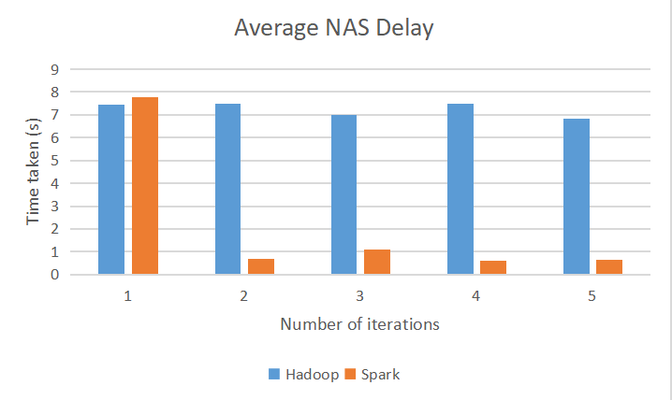
Query Execution Results

Slide 6
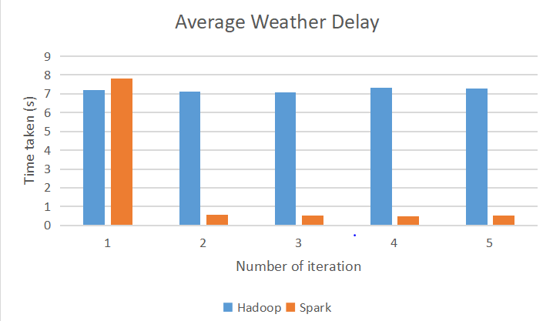
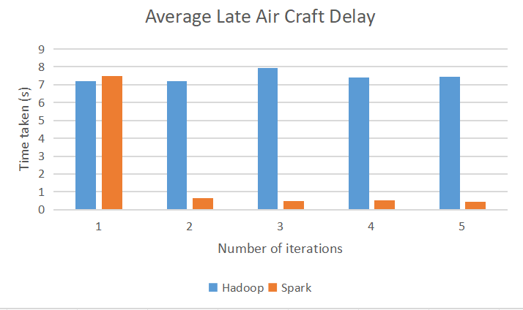
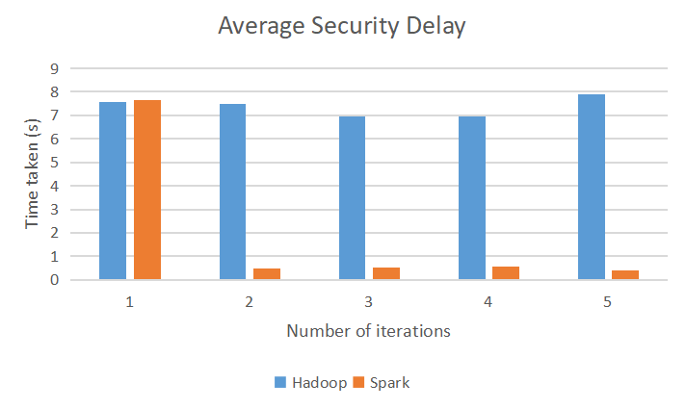

Slide 7
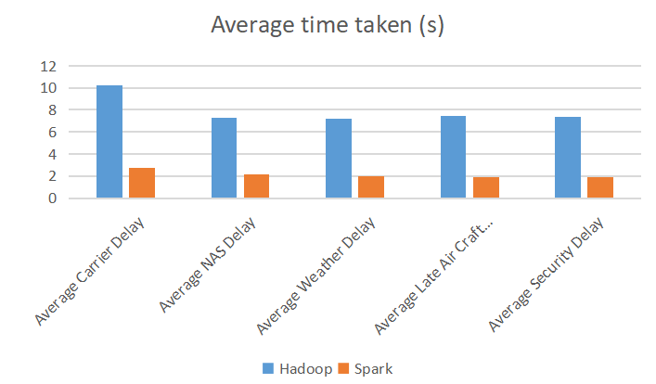
Average Query Execution Time

Slide 8
Comparison on MapReduce and Apache Spark
 | MapReduce | Apache Spark
Ease of use | Requires more technical know-how, like understanding Java, and can be tricky to debug. | Easier for developers because it's simpler and supports various languages.
Fast process | Takes longer because it reads and writes to disk a lot. | Faster because it keeps data in memory and doesn't need to read and write to disk as much.

Slide 9
Conclusion
MapReduce:
Established framework for distributed computing, but requires manual configuration and low-level programming.
Operates in a batch-oriented manner, leading to slower processing.
Apache Spark:
Offers high-level APIs in multiple languages, making it accessible to a wide range of developers.
In-memory processing engine leads to significantly faster computation speeds compared to disk-based frameworks.
Comprehensive solution with built-in libraries for SQL processing, machine learning, graph processing, and stream processing.

Slide 10
Thank You

